Slide 1
Functions and Modules and docstring

Slide 2
Lesson #2 Learning Outcomes
Functions
Flow of Control
Comments and DocString
Modules
Arithmetic Operators
Assignment Operators
Main Function

Slide 3
Functions
The function is a group of related statements with a name (a verb) that perform a task.
Functions can be called procedures, sub-routines, or methods.
Functions allows us to divide the code into smaller modules which makes it easier to read, test, and use.
Functions can be either built in (e.g. print) or user defined (e.g. a function to solve a homework problem).
Functions allows us to organize our code, make it more readable, reuse it and save time.
Ideally each function should perform one task.
Use functions to divide and conquer a larger task.

Slide 4
Function General Syntax
def function_name( parameter(s) ):
statement
statement
statement
etc.
function header aka function signature: marks the beginning of the function
parameters aka arguments: comma-separated list of input variables
colon:
function block: the statements that will be executed when the function is called, possibly contains a return statement (output)
The code is indented inside the function

Slide 5
Function General Syntax: Example
def print_name_uppercase(first_name, last_name):
print(first_name.upper(), end=" ") # may or may not be ok; ok if first_name is a string only
print(str(last_name).upper()) # ok to use upper() for sure, since last_name is definitely a string
print_name_uppercase("tiGeR", "woODs")
print_name_uppercase("tiGeR", 5) # ok; the function changes 5 to a string, which has an upper()
print_name_uppercase(5, "woods") # crash; 5 is an integer; integers don't have an upper() method
Good coding style is shown above:
Function is defined first, before using it (i.e. defined “above” where it is called)
Function is named as a verb
Function has clear parameter names
Function is indented inside
Two lines separate the function definition from the code around it

Slide 6
Function Coding Style
Function name should be descriptive and contain all lowercase characters, use snake case if the function name consists of more than one word.
Example get_data(), display_result(), multiply_numbers().
Function body must be indented from the function header (signature).
By default indentation is four spaces.

Slide 7
Function Variants
Functions can be built in or user defined.
Built-in functions are functions that come with Python standard library.
Example: print(), input(), str(), int(), type().
User-defined functions are defined by ourselves to do a certain specific task.
Functions may return 0 or 1 value.
Functions that return a value are immediately ended at the “return” statement; you can’t have code after a return statement.
Functions may or may not receive parameters (arguments).

Slide 8
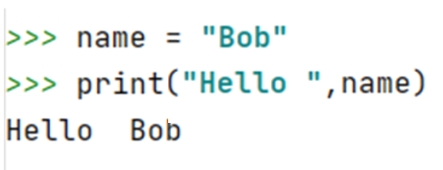
Void Functions and Value-Returning Functions
Void function is a function that does not return a value, it simply executes its statements then terminates.
print() is an example of a void function.
Function print displays the message and does not return any value.

Slide 9



Calling a Function
To call a function, it must be defined FIRST; then simply place the function name followed by ().
Pass any parameters if required.
Example:
Function Definition
Output
Function Call

Slide 10

Value Returning Function
Value-returning function executes any statements then returns a value to the point where it was called.
Often, the returned value is assigned to a variable to be further used in the script.
input() is an example of a value-returning function.
Example:

Slide 11


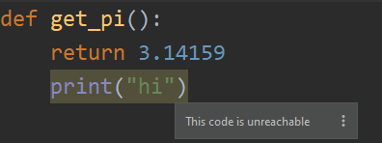

Value-Returning Function
- Return also terminates that function.
Example:
Function Definition
Output
Function Call

Slide 12
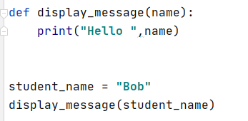

Functions
Functions may or may not receive parameters a.k.a. arguments.
Example:
print(get_pi()) # empty ()
Function that does not receive any parameter(s)
Function that receive parameter(s)
Output:

Slide 13
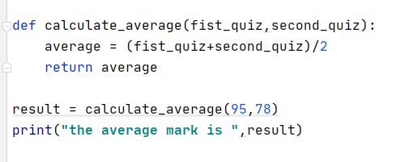

Functions
Functions may take more than one parameter that are separated by commas.
If no parameters are given then the function should be defined with an empty set of parentheses
Example:
Output

Slide 14
Flow of Control
A function must be defined before it is called.
In order to ensure that a function is defined before its first use, you have to know the order in which statements are executed, which is called the flow of execution.
Execution typically begins at the first statement of the program. Statements are executed one at a time, usually in order from top to bottom.

Slide 15
Flow of Control
Function definitions do not alter the flow of execution of the program, but remember that statements inside the function are not executed until the function is called.
A function call is a detour in the flow of execution. Instead of going to the next statement,
the flow jumps to the body of the function,
executes all the statements there,
and then comes back to pick up where it left off.

Slide 16
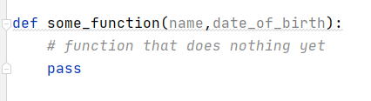
Function Stub
To create a function without a meaningful body, you can stub it out.
The pass keyword is an instruction that does nothing. It is used as a placeholder when a statement is required syntactically, but no code needs to be executed – it’s purely for stubbing out a function or indented block of code.
The developer is saying “I’ll fill this in later”.
Example:

Slide 17
Comments Vs DocString
Comments are lines of text that appear in the code and are ignored by the Python interpreter .
Comments are created by adding the symbol # at the beginning of the comment.
Comments are useful to explain non-obvious portions of the code and can be useful for comments on fixing bugs and tasks that are needed to be done.

Slide 18
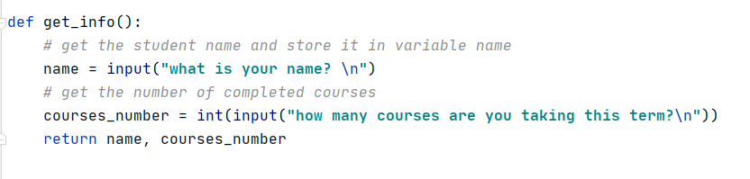
Comments

Slide 19
DocString
DocStrings are similar in spirit to commenting, but they are enhanced, more logical and formal, and useful version of commenting.
DocStrings provide a description of use and functionality of your code for the intended audience (other developers).
It helps the developer to understand the code, its purpose and design.
The description includes the function behavior, its arguments, return value and other attributes and restrictions.

Slide 20
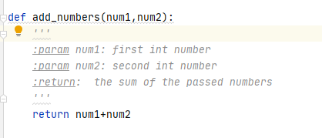
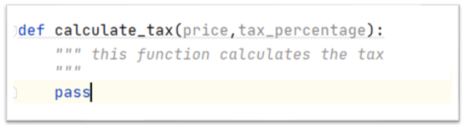
DocString
A DocString is a string literal that uses TRIPLE quotation marks that occurs as the first statement in a module, function, class, or method definition.
Such a DocString becomes the __doc__ special attribute of that object. It’s like a user manual for how to use this module (e.g. this function). Other developers now know what your function will do.
Triple quotation marks can be used to create a single line or a multi-line DocString.
Use these DocStrings in every function in this course.
Example:

Slide 21
DocString
def get_circle_area(radius):
"""
:param radius: the radius of a circle whose area is to be calculated (half the diameter)
:return: pi times radius squared, the area of the circle
"""
return 3.14 * radius**2

Slide 22
Python Scripts vs Python Modules
A plain text file containing Python code that is intended to be directly executed by the user is called a script, which is an informal term that means top-level program file.
Generally, the script contains your "main“ function, where the program starts to run.
A module is a Python file which contains predefined functions that are designed to be imported and used by another Python file.
You must import the module with an import statement before you can use it.
https://docs.python.org/3/library/__main__.html

Slide 23
Top-Level Script Environment
# c.py
def main():
print("main in c")
if __name__ == "__main__":
main()
If we directly execute this file, main is called
but if this file is imported by another file, this
main is not called
# d.py
import c
def main():
print("main in d")
if __name__ == "__main__":
main()
If we directly execute this file, d’s main is called but c’s main is not; if we really want d to call c’s main, we can call it via c.main()
In this case, d is a script and c is a module

Slide 24
Python Scripts vs Python Modules
Module: my_module.py
Script: my_script.py
def say_hi(name):
print("hi %s " % str(name))
import sys # a python module for sysadmin stuff
import os # a python module for operating system stuff
import my_module # my own personal module
my_module.say_hi("tiger woods") # WE MUST IMPROVE ON THIS

Slide 25
Python Scripts vs Python Modules
Module: my_module.py
Script: my_script.py
def say_hi(name):
print("hi %s " % str(name))
A MODULE IS NOTHING BUT A GROUP OF FUNCTIONS; NOTHING IS RUNNING
import sys # a python module for sysadmin stuff
import os # a python module for operating system stuff
import my_module # my own personal module
my_module.say_hi("tiger woods") # WE MUST IMPROVE ON THIS
A SCRIPT ALSO RUNS CODE!

Slide 26
Python Scripts vs Python Modules
Module: my_module.py
Script: my_script.py
def say_hi(name):
print("hi %s " % str(name))
import sys # a python module for sysadmin stuff
import os # a python module for operating system stuff
import my_module # my own personal module
def main():
my_module.say_hi("tiger woods") # MAIN function starts the program
if __name__ == "__main__":
main()

Slide 27
Built-in Modules
Python provides a large number of pre-defined functions in a large number of pre-defined modules that are available as a part of Python library.
In the following slides we will explore some of the frequently-used modules.

Slide 28
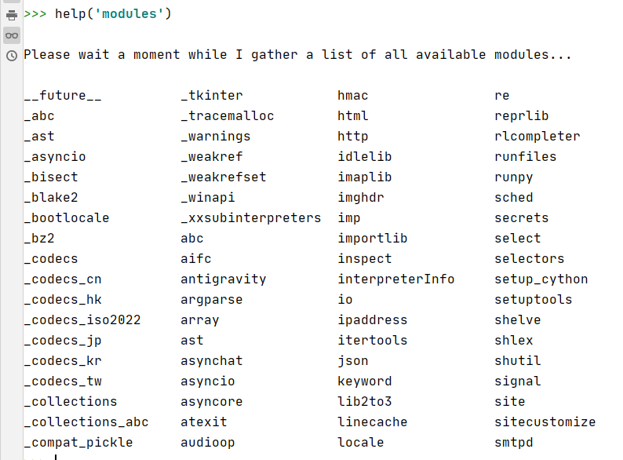
Built-In Python Modules
To display a list of all available modules, use the following command in Python console.

Slide 29
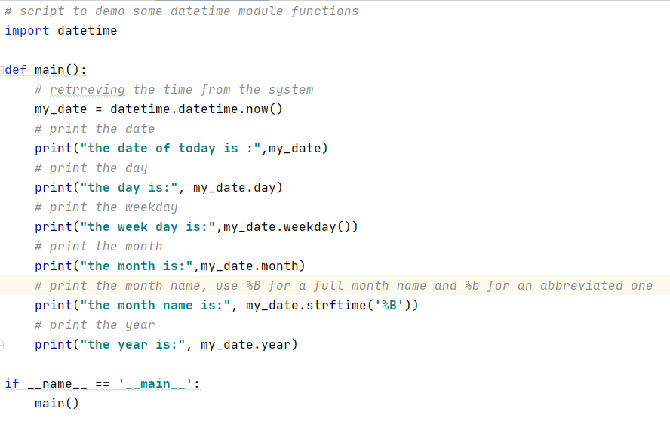
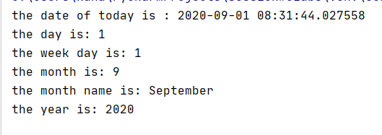
Built-In Python Modules datetime Module
datetime is a Python module to process time related elements

Slide 30
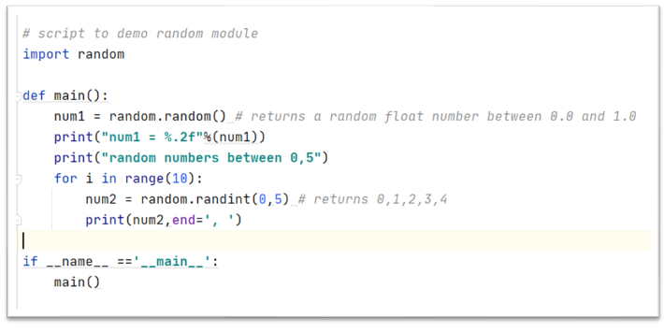
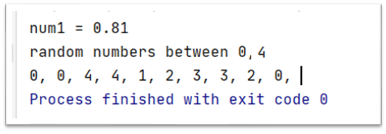
Built-In Python Modules random Module
Random module allows the user to generate random numbers.

Slide 31
Arithmetic Operations
Recall from the previous session arithmetic operators (+, -,*,/,//,**) were discussed.
In Python operator % is called modulus operator, it is used to retrieve the remainder after the division
Example:
7 // 2 = 3, R = 1
3 * 2 = 6 + 1
7 % 2 = 1

Slide 32
Assignment Operators
Operator | Description | Example
= Assign | Assigns the value from right side operands to the left side operand | c = a + b
+= Add and | Adds right operand to the left operand and assigns the result to the left operand | c+= a is equivalent to c= c + a
-= Subtract and | It subtracts right operand from the left operand and assign the result to left operand | c -= a is equivalent to c = c - a
Do not use the operators below here: They are very confusing. Our main goal is to write clear code.
*= Multiply and | It multiplies right operand with the left operand and assign the result to left operand | c *= a is equivalent to c = c * a
/= Divide and | It divides left operand with the right operand and assign the result to left operand | c /= a is equivalent to c = c / a
%= Modulus and | It takes modulus using two operands and assign the result to left operand | c %= a is equivalent to c = c % a
**= Exponent and | Performs exponential (power) calculation on operators and assign value to the left operand | c **= a is equivalent to c = c ** a
//= Floor division and | It performs floor division on operators and assign value to the left operand | c //= a is equivalent to c = c // a

Slide 33
Assignment Operators
x = 6
x+=5 # x is now 11
x-=2 # x is now 9
x//=4 # you just lost all your friends; do not do this
x = x // 4 # Instead, do this
If you’re writing a novel, your job is to be clear. Do not make your readers check a thesaurus or dictionary for every word.
Be simple. Be clear.

Slide 34
Operators Precedence
By default the descending order of the arithmetic operators in python is as follows:
() Parentheses can be used to change the order of precedence of the operations
Operator | Meaning
** | Exponent
* , /, // , % | Multiplication, Division, Floor Division, modulus
+ , - | Addition, Subtraction

Slide 35
Operators Precedence
Example:
10 – 4 * 2 = 2 because the multiplication will be executed before the subtraction
4 * 2 = 8 and then 10 – 8 = 2
Make it clearer! 10 - (4 * 2) Add in parentheses for clarity
(10 – 4) * 2 = 12 with the parentheses the subtraction will be executed before the multiplication
10 – 4 = 6 and then 6 * 2 = 12
With the Parentheses the order of operation is:
Operator | Meaning
() | Parentheses
** | Exponent
* , / , // , % | Multiplication, Division, Floor Division, modulus
+ , - | Addition, Subtraction

Slide 36
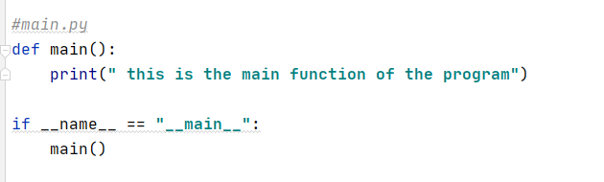

Main Function
Python convention is to define a “main” function for your program.
Example:
Output:

Slide 37
The main() Function
This allows your main function to be the starting (entry) point of the execution of the program.
Also the script that has this function can be imported as a module into other scripts.
Using this convention allows you to write code that can be run directly or imported.
This is a practice I expect to see in your Python scripts.

Slide 38
The main() Function
# my_module.py
def say_hi(name):
print("hi %s " % str(name))
# my_script.py
import my_module
def main():
my_module.say_hi("tiger woods")
if __name__ == "__main__":
print("my_script is the main")
main()
# main_script.py
import my_script
if __name__ == "__main__":
print("main_script is the main")
my_script.main()
Since my_script is being imported by main_script, my_script is being used as a module so it will NOT execute its own main(). Instead, main_script is being used as a script (since it is not being imported by anything) and it WILL call main().

Slide 39
Next Week Homework
Review the material
Complete the lab
Quiz next lesson
Read sections 3.1 to 3.6 from the book: https://www.py4e.com/book.php
Prepare for the quiz which will be mostly about the topics of this lesson (#2) and a little bit on the assigned readings (3.1 to 3.6)

